Slide 1
Android's Graphics
JULURI SAIPRANAY

Slide 2
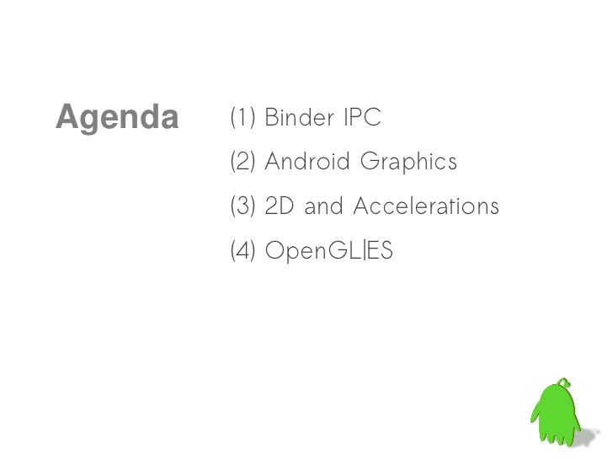

Slide 3


Slide 4
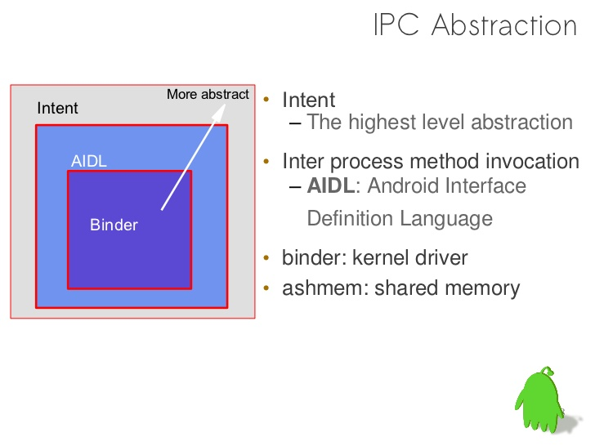

Slide 5
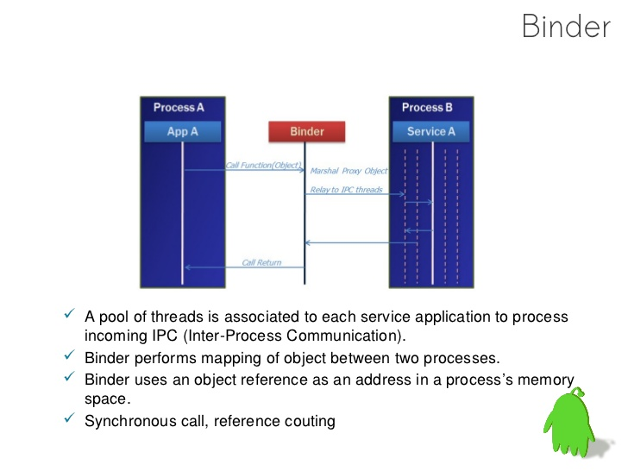

Slide 6
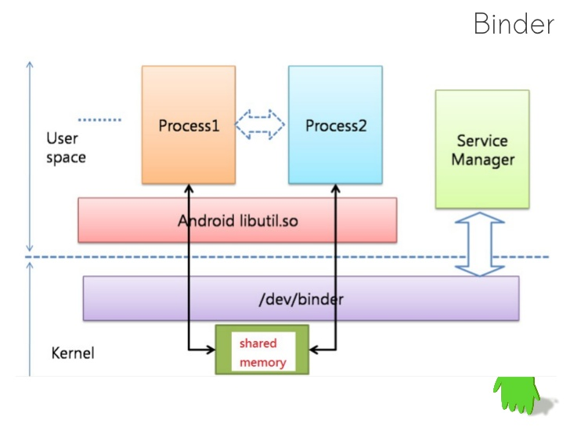

Slide 7
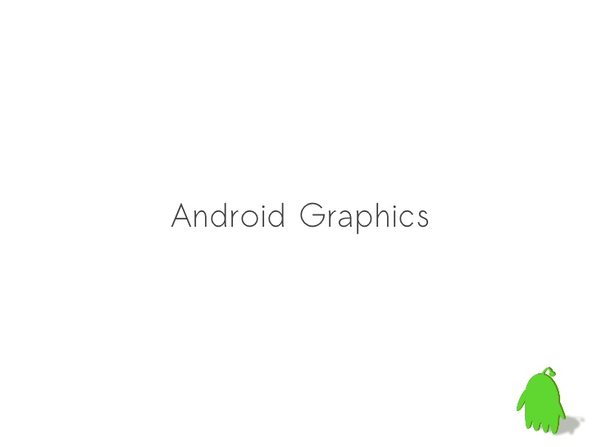

Slide 8
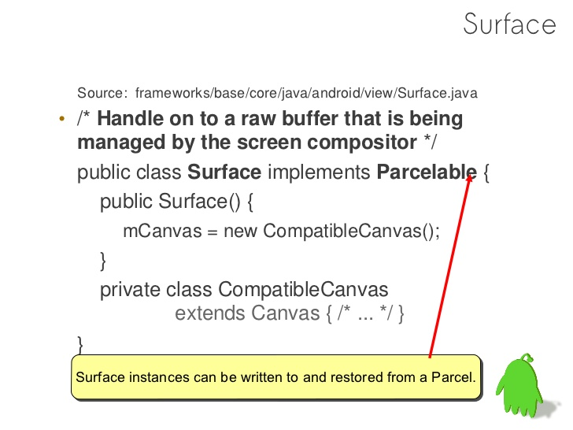

Slide 9
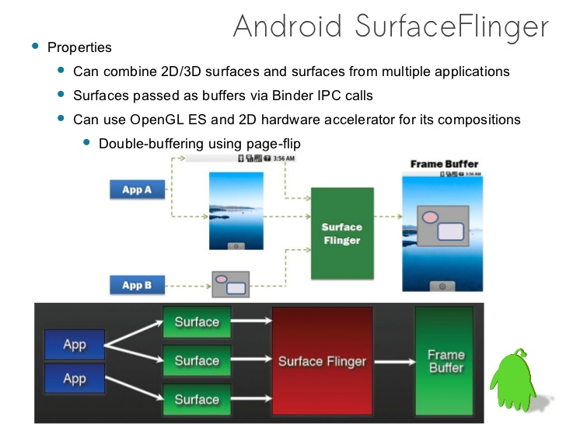

Slide 10
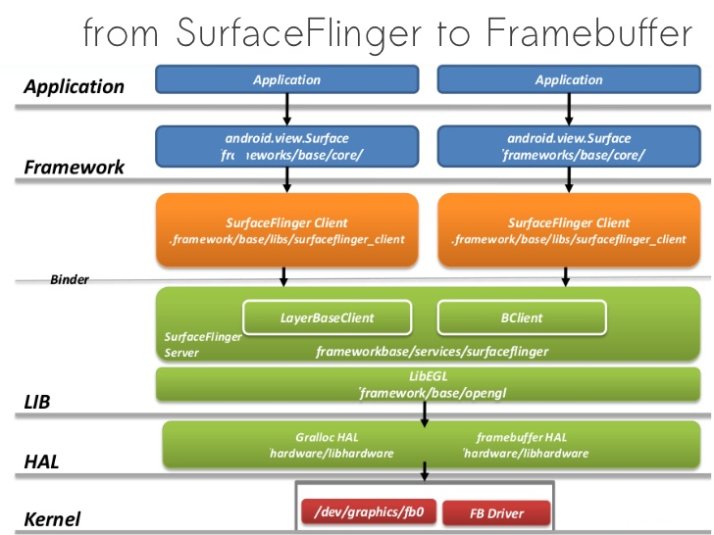

Slide 11
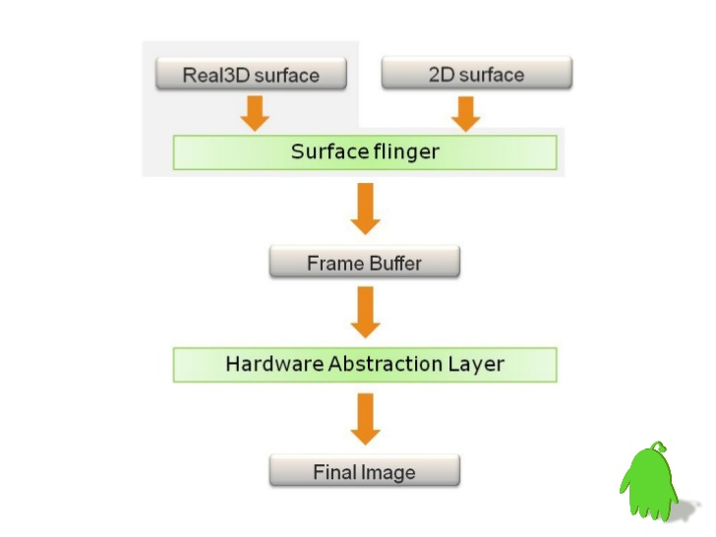

Slide 12
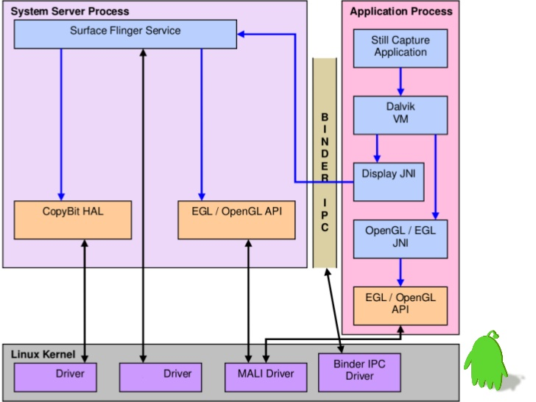

Slide 13
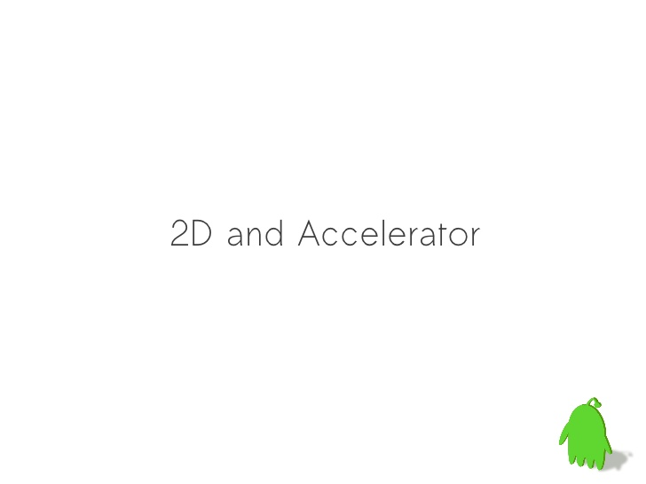

Slide 14
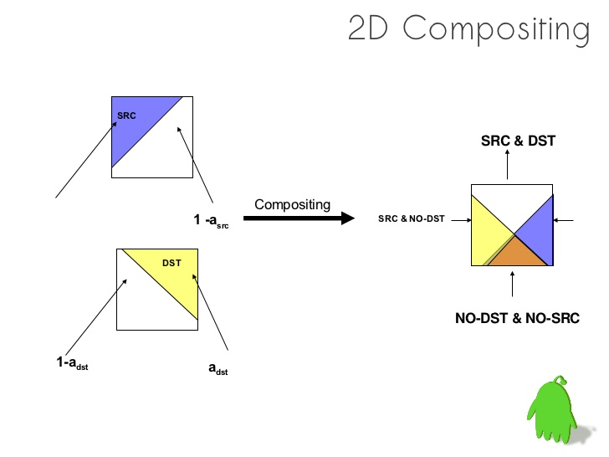

Slide 15
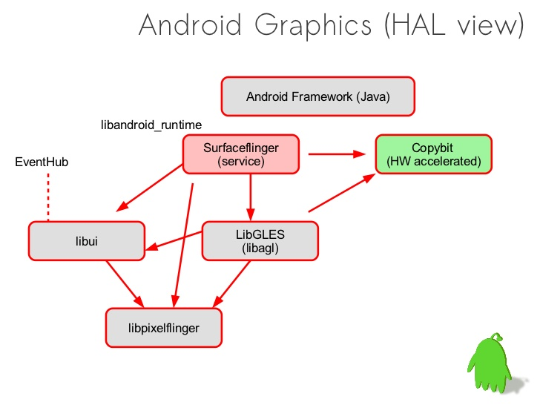

Slide 16
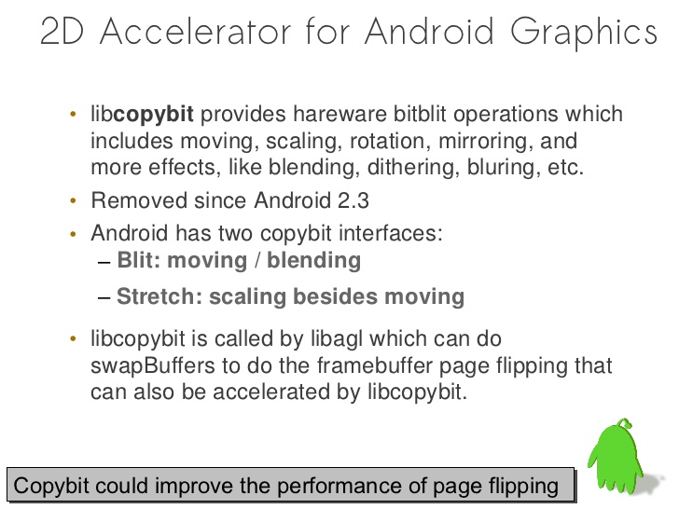

Slide 17


Slide 18
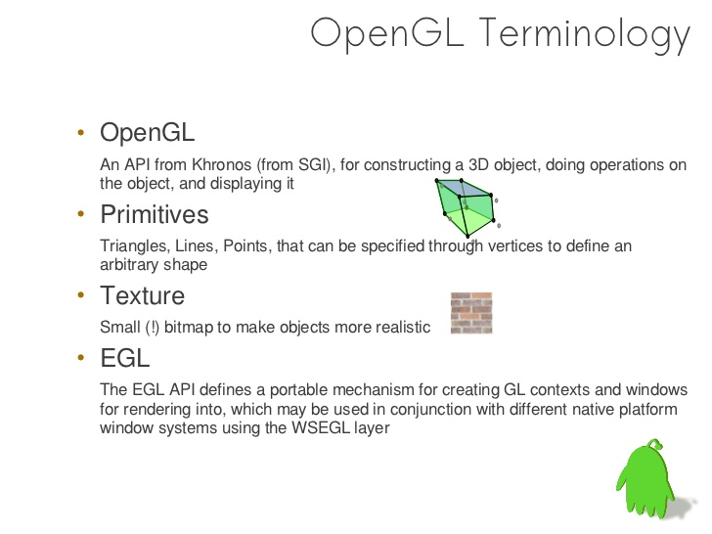

Slide 19
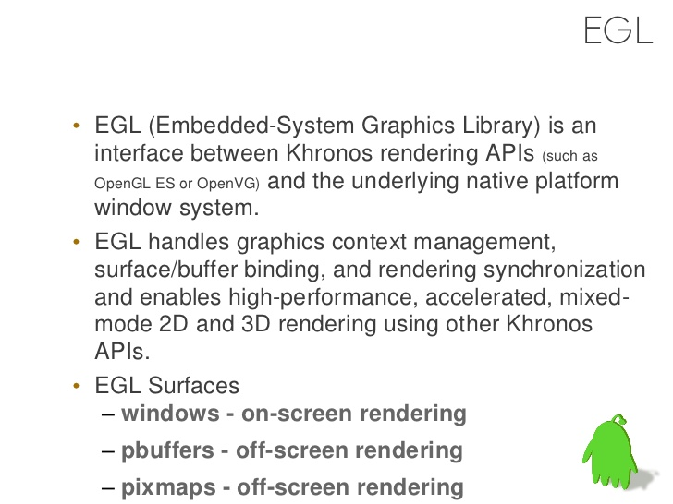

Slide 20
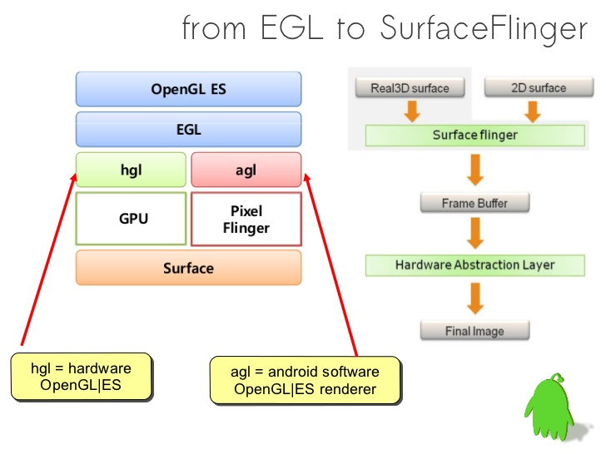

Slide 21
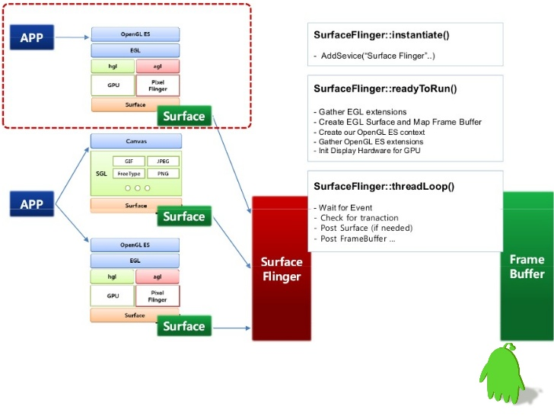

Slide 22
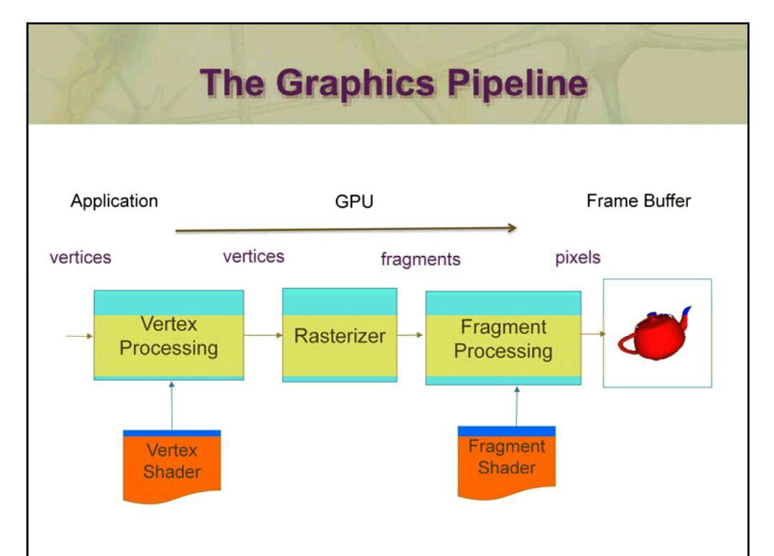

Slide 23
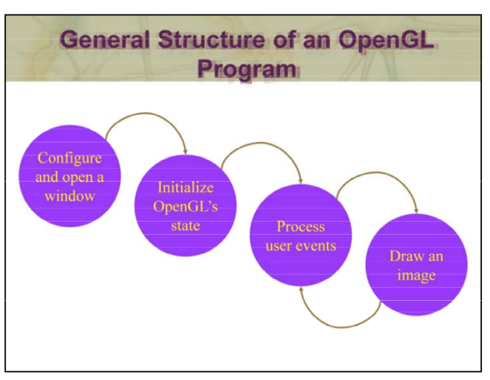

Slide 24
The general flow of an interactive application, including OpenGL applications is:
1.Configure and open a window suitable for drawing OpenGL into.
2. Initialize any OpenGL state that you will need to use throughout the application.
3. Process any events that the user might have entered. These could include pressing a key on the keyboard, moving the mouse, or even moving or resizing the application’s window.
4. Draw your 3D image using OpenGL with values that may have been entered from the user’s actions, or other data that the program has available to it.

Slide 25
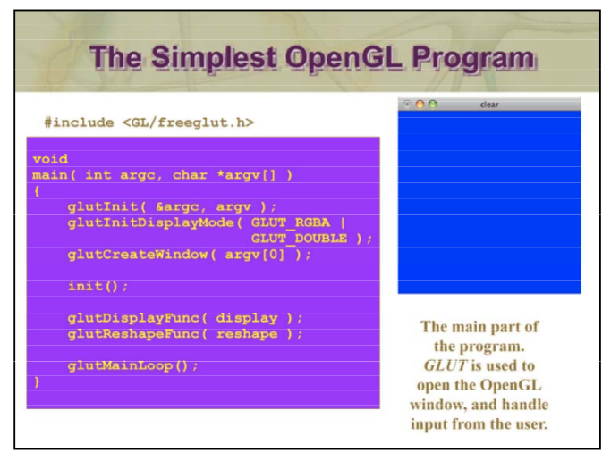

Slide 26
This contains the program statements for the main() routine of a
C program that uses OpenGL and GLUT.
All GLUT-based OpenGL programs begin with configuring the GLUT window that gets opened.
Next, in the routine init() (detailed on the following slide), “global” OpenGL state is configured. By “global”, we mean state that will be left on for the duration of the application
After initialization, we set up our GLUT callback functions, which are routines that you write to have OpenGL draw objects and other operations. Callback functions, if you’re not familiar with them, make it easy to have a generic library (like GLUT), that can easily be configured by providing a few routines of your own construction.
Finally, as with all interactive programs, the event loop is entered. For GLUT-based programs, this is done by calling glutMainLoop(). As glutMainLoop() never exits (it is essentially an infinite loop), any program statements that follow glutMainLoop() will never be executed.

Slide 27
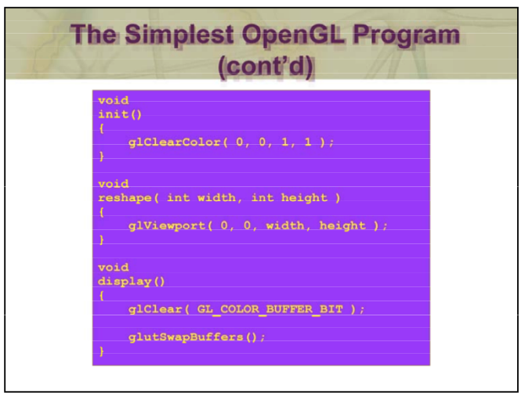

Slide 28
We use the init() routine configure settings that aren’t going to change across the execution of a program. In this case, we show our first OpenGL routine, glClearColor(), which specifies the color that the window will show when it’s cleared.
Finally, we specify the glutReshapeFunc() callback – display() – w hich is were we’ll do all of our drawing. For this simple application, we do to rendering operations:
we clear the window using the OpenGL routine glClear(). You’ll notice that it takes a parameter that specifies we want to clear the color buffer. We’ll see that there are other buffers for our use in a bit.
2. finally, we swap the buffers by calling glutSwapBuffers(). Well talk more about double-buffered rendering later as well.

Slide 29
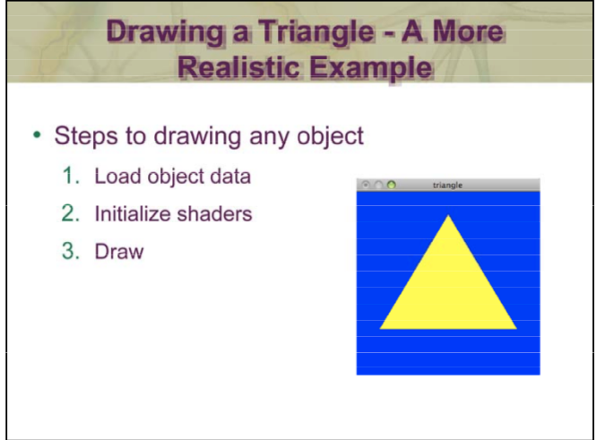
This example shows loading object data, initializing the required shaders, and rendering. Every application leverages these steps –just with more data and complex shaders. We’ll discuss the specifics of the process in more detail as we proceed.

Slide 30
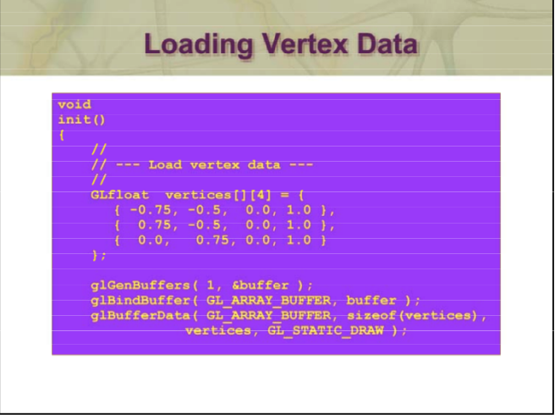

Slide 31
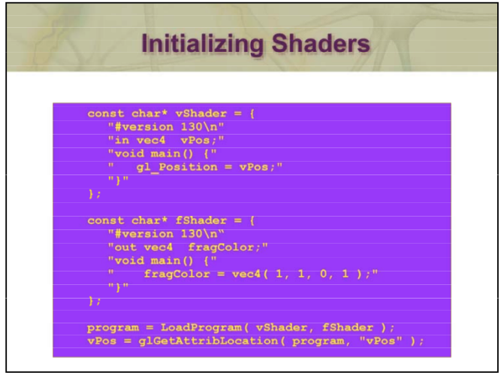

Slide 32
The variable vShader contains the source to our vertex shader. This is about the simplest vertex shader you can have. Similarly, the variable fShader contains the source of our fragment shader which determines the color of the pixel. Here, we set the color of all the pixels to a constant color.
We pass the shaders into a helper routine we’ve written for the course named LoadProgram(), which takes a vertex shader and a fragment shader (), and creates a GLSL “program” from them. We’ll show the internals of LoadProgram() later, but assuming that there aren’t errors in your shaders (they’re really small programs that get compiled, and can have errors – LoadProgram() will report them to you if there’s a problem), it will create a usable shader program we’ll use later.
The last line retrieves information about a variable in (in this case the The last line retrieves information about a variable in (in this case, the variable “vPos”) that we’ll need later when it comes time render. For the curious, all variables labeled “in” in a vertex shader are assigned a location index that we need to initialize to pass data into

Slide 33
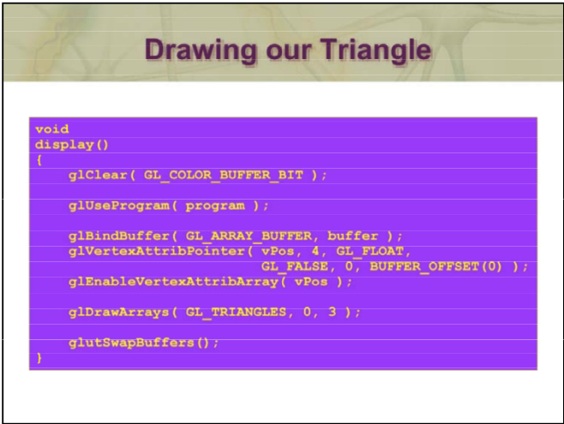

Slide 34
Here is the entirety of our routine for drawing. As you’ve seen, we first clear the window by calling glClear().
Next, we enable the shader program that we initialized in init() previously. After this, all data is processed by that program until we turn it off, or switch to using another shader program.
Next, we tell OpenGL where to find the data for our object, and use the location value vPos that we retrieved in init() to associate our data with location value – vPos – that we retrieved in init() to associate our data with a variable in a shader. After making the association, we tell OpenGL that it should use the data for that connection. That might seem redundant, but it’s really an option for flexibility. Depending on how you will want to draw something, you may find it simpler to load lots of data for an object, and switch between subsets of that data as you draw different versions of it. We’ll show you how you might do that in just a bit you how you might do that in just a bit.
We draw the object by calling glDrawArrays(), in this case specifying that we’d like to draw triangles. It’s just one method of drawing objects

